Slide 1
Chapter 6: Test Management
Software Testing
Lecture 24
Test Management

Slide 2
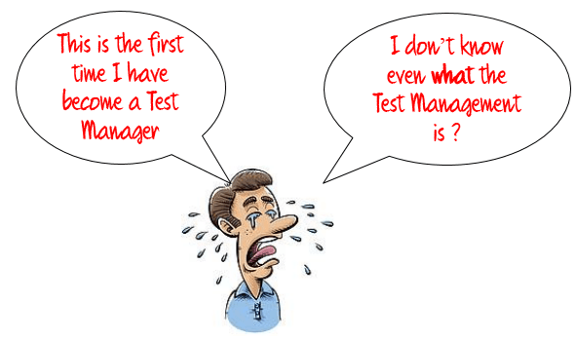
Test Management
Why do we need test management?
- Quality products
- Meeting deadlines

Slide 3
Test Management
Important part of s/w quality is the process of testing and validating
Process of managing testing activities
Goal is to allow teams to plan, develop, execute and assess all the testing activities within the overall software development effort.
Test management challenges:
- Why should I test?
- What should I test?
- Where do I test?
- When do i test?
- How do I conduct the test?
- Not enough time or resources to test?
- Testing teams are not always at one place
- Difficulties with requirements
- Keeping in sync with development
- Reporting the right information

Slide 4
Test Management Process
Test Organization
Test Planning
Costs and Economy Aspects
Choosing the test strategy and test approach
Managing the test work
Incident management

Slide 5
Test Organization
Test Teams:
Testing activities are necessary
Developer test
Blindness to one’s own errors
Independent testing
Reporting of failures
Mutual comprehension

Slide 6
Independent testing
Why need independent testing?
Benefits:
Improved Software Quality
Experienced and Skilled Manpower
Lower Costs
Reduced Time to Market
Flexibility

Slide 7
Independent testing
Drawbacks:
Too much isolation
Communication problems
Lack of necessary resources
Developers may loose sense of responsibility

Slide 8
Models of Independent Testing
Testing done by developer himself
Independent testers ceded to the development team
Independent Testing Team within Organization
Independent Testers of different Organization
Outsourced test team members of other organization

Slide 9
Tasks and Qualifications
Specialists with knowledge covering the full scope of activities in the test process should be available. The following roles should be assigned:
Test manager (test leader): Test planning and test control expert(s), possessing knowledge and experience in the fields of software testing, quality management, project management, and personnel management.
Test designer (test analyst): Expert(s) in test methods and test specification, having knowledge and experience in the fields of software testing, software engineering, and (formal) specification methods.
Test automator: Test automation expert(s) with knowledge of testing basics, programming experience, and deep knowledge of the testing tools and script languages. Automates tests as required, making use of the test tools available for the project.
Test administrator: Expert(s) for installing and operating the test environment (system administrator knowledge). Sets up and supports the test environment
Tester: Expert(s) for executing tests and reporting failures (IT basics, basic knowledge of testing, using the test tools, understanding the test object).

Slide 10
Tasks and Qualifications
Tester:
Typical tasks are as follows:
Reviewing test plans and test cases
Using test tools and test monitoring tools (for example, to measure performance)
Executing and logging tests, including evaluating and documenting
The results and detected deficiencies

Slide 11
Social Competence for Tester
To be successful, in addition to technical and test-specific skills, a tester needs social skills:
Ability to work in a team, and political and diplomatic aptitude
Skepticism (willingness to question apparent facts)
Self control and Persistence
Accuracy and creativity
Ability to get quickly use to with (complex fields of) application

Slide 12
Thank you

